Slide 1
MediTrack
Hospital patient data analysis system
A python based system for organizing hospital visit records and exploring visit patterns through data analysis
2nd year | B. Tech | Department of CSE

Slide 2
The Problem
Manual Inefficiencies: Traditional data management using registers or basic spreadsheets is time-consuming and prone to errors.
Data Retrieval: Identifying specific patient history and records from unstructured data is highly difficult.
Lack of Analytics: Tracking department-wise workloads, patient demographics, and visit trends requires tedious manual calculation.
Visual Deficit: Absence of graphical reporting makes it hard to quickly interpret hospital operations and make decisions.

Slide 3
Our Solution – MediTrack
Centralized Platform: A web-based application that securely manages patient details and hospital visits in one place.
Automated Analytics: Uses data science libraries to process records and automatically identify visit patterns.
Data Visualization: Transforms raw hospital data into easy-to-understand graphical reports.
User-Friendly: Replaces messy manual records with a clean, organized, and easily searchable digital interface.

Slide 4
Key Features
Secure Authentication: Role-based login and registration system.
Patient & Visit Management: Add, edit, search, and filter comprehensive patient profiles and visit histories.
Demographic Insights: Automatic breakdowns of patient populations by age, gender, and blood group.
Visual Dashboard: Real-time generation of charts showing daily/monthly trends and department workloads.
Data Exporting: One-click downloads of records and reports.

Slide 5
How MediTrack Works
1. User Interface: Browser requests via HTML/CSS/JS.
2. Application Layer: Python/Flask handles routing and logic.
3. Database Layer: MySQL stores and retrieves patient/visit data.
4. Analysis Layer: Pandas and NumPy process the retrieved data.
5. Visualization: Matplotlib generates charts sent back to the User Interface.

Slide 6
Technology Stack
Frontend: HTML5, CSS3, JavaScript
Backend: Python, Flask
Database: MySQL, MySQL Connector
Data Analysis: Pandas, NumPy, Matplotlib
Deployment & Tools: Gunicorn, VS Code

Slide 7
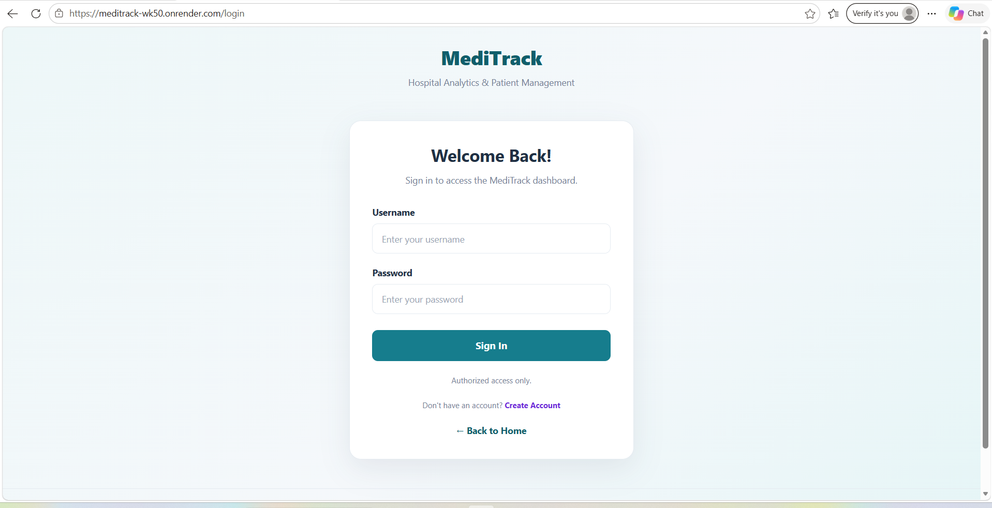
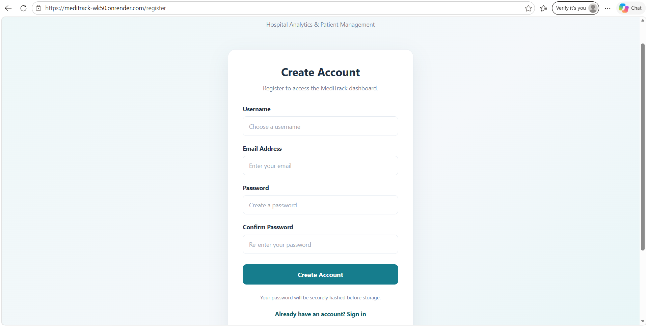
Secure Access (Login & Registration)
Login page
Registration page
Key Context: Showcases the secure entry point for hospital staff and the intuitive main navigation dashboard designed for quick access to core modules.

Slide 8
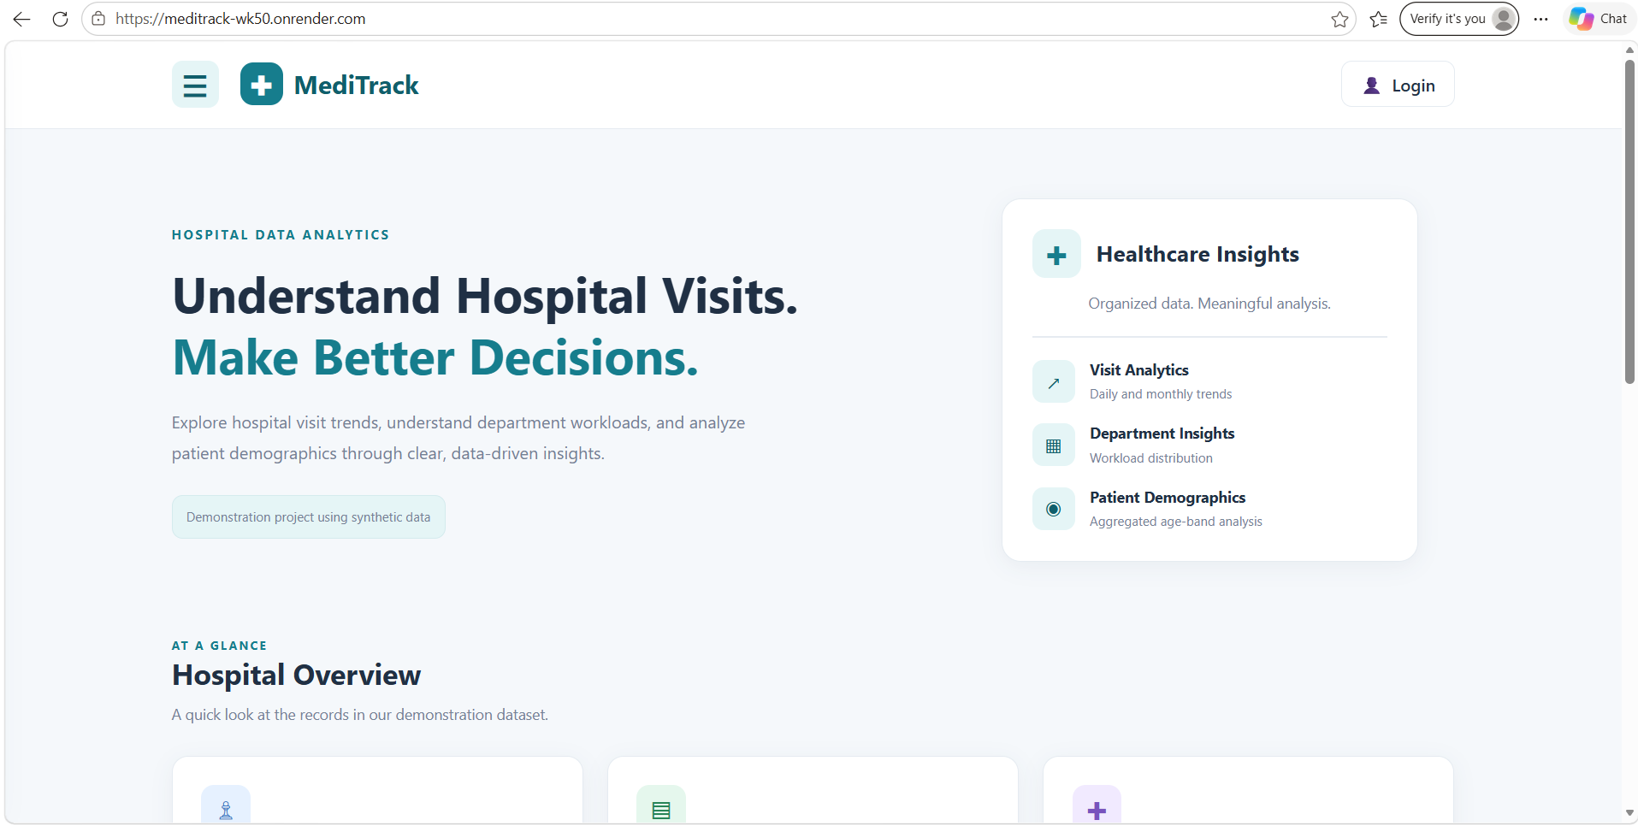
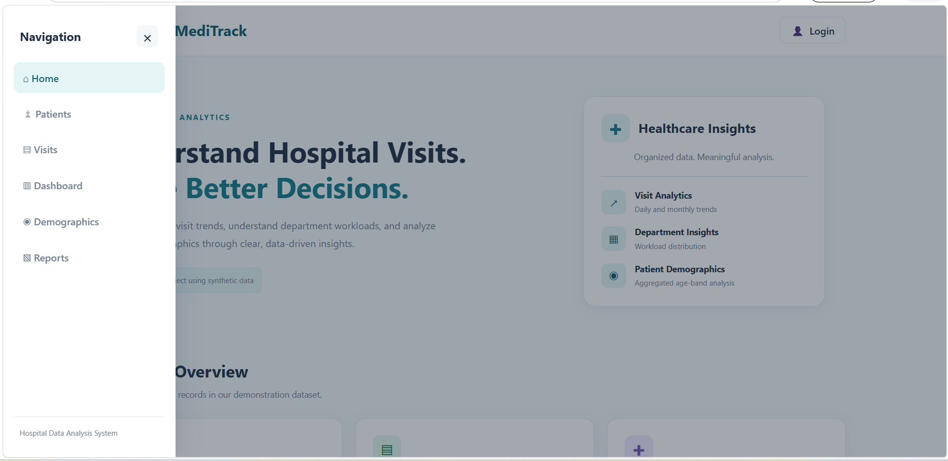
Central Hub (Home Page Navigation)
Home page
Navigation bar
Key Context: Focus on user experience. Explain that the home page acts as the main navigation point, allowing staff to quickly jump between patient management, visit records, demographic analysis, and analytical reports.

Slide 9
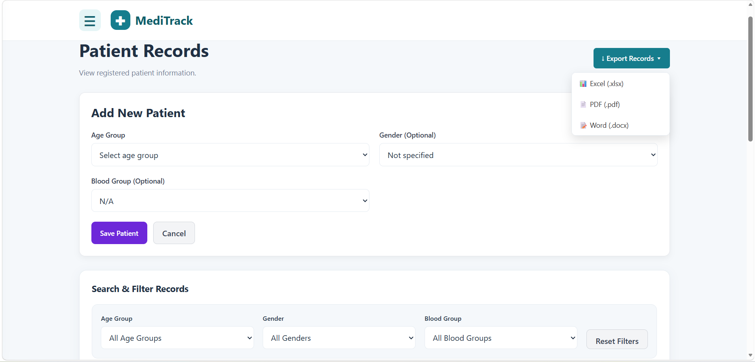
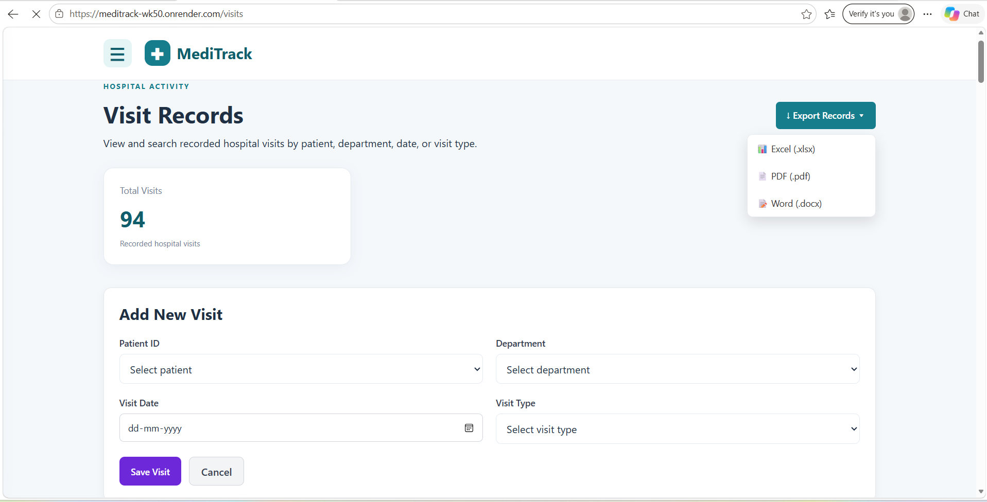
Patient & Visit Management
Adding patient records
Adding visit records
Key Context: Demonstrates the structured forms for adding new patients and the searchable, filterable data tables that track check-ups, consultations, and follow-ups by department.

Slide 10
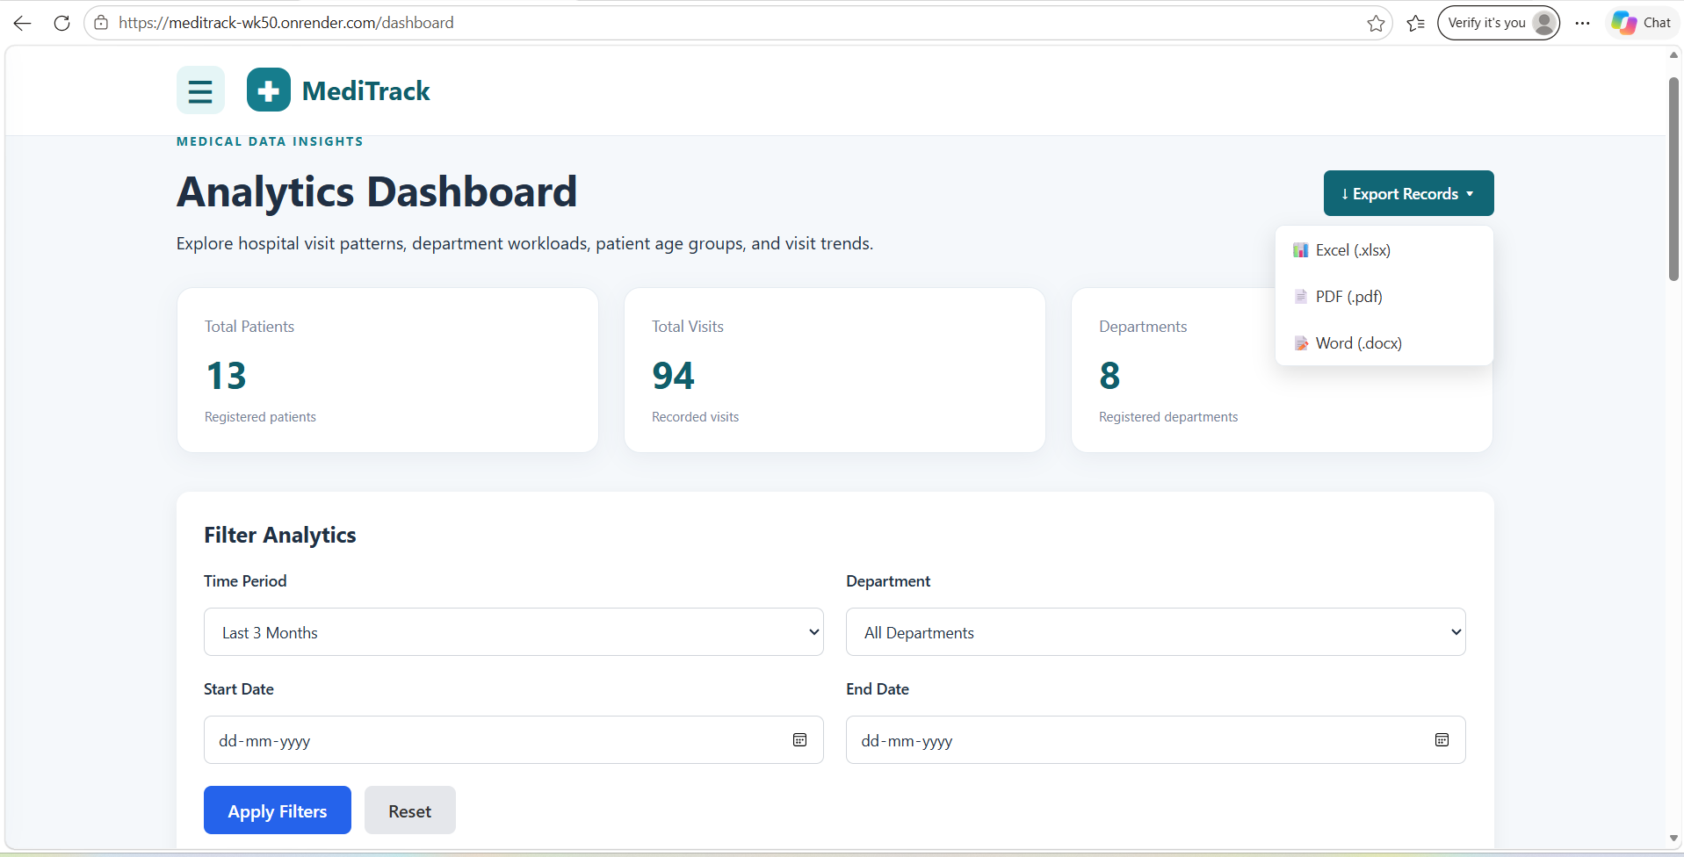
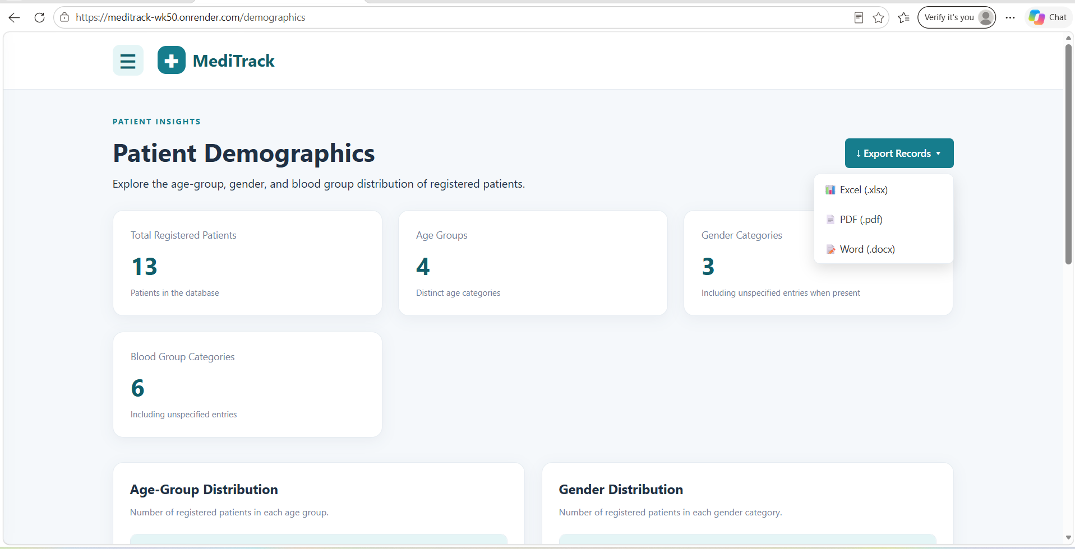
Insights from Data
Analytics page
Demographics page
Key Context: Highlights the core value of MediTrack—turning raw data into visual insights showing exactly which departments are busiest and what the monthly patient influx looks like.

Slide 11
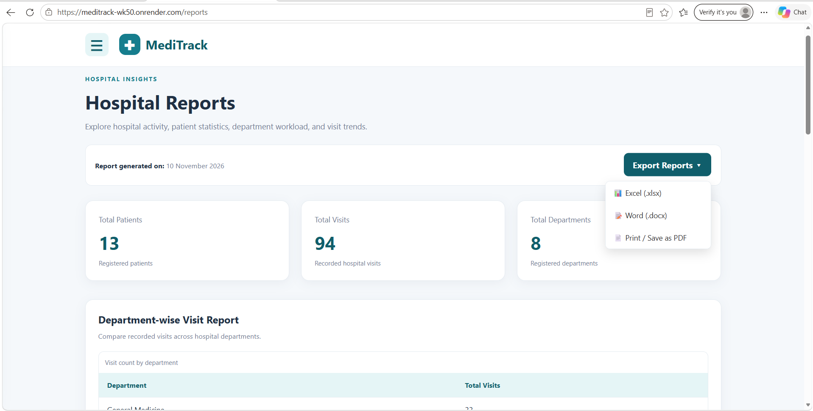
Beyond Analytics
Page-Wise Data Export
Each page provides an individual export option.
Users can download only the data relevant to the selected page.
Supports PDF, Excel and Word formats.
Makes data retrieval more flexible and convenient.
Key Context: Emphasizes that data isn't trapped in the app. Staff can seamlessly export reports to Excel (.xlsx), PDF, or Word (.docx) for external sharing and printing.

Slide 12
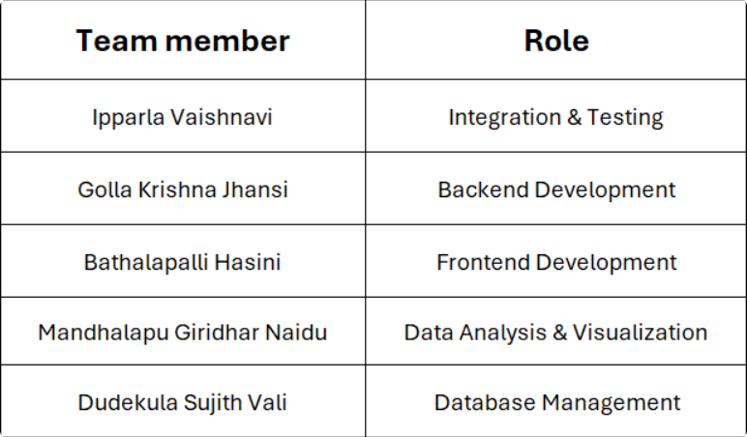
Development Journey

Slide 13
Conclusion
Achievements: Successfully integrated web development, database management, and data analysis into a cohesive, working healthcare tool.
Future Scope:
  Appointment scheduling and booking.
  Automated email/SMS notifications for follow-ups.
  Advanced predictive analytics for hospital resource planning.
Thank You!

